Slide 1

Intelligent Load Balancing
Cloud Deployed ML Models and UNIX Daemons
Project Group Members:
Chirag Khatri - [ A010145024198 ]
Arpeet Rout - [ A010145024199 ]
Nipun Garg - [ A010145024203 ]
Preeti Devi - [ A010145024201 ]
Academic Year: 2024-2026 | Institution: Amity University

Slide 2


The Problem: Static Load Balancing
Static Algorithms
Traditional load balancers use fixed, non-adaptive algorithms.
Reactive Approach
Cannot adapt to dynamic workload patterns; they react only after overload occurs.
Manual Tuning
Requires constant manual optimization and adjustment for performance.

Slide 3

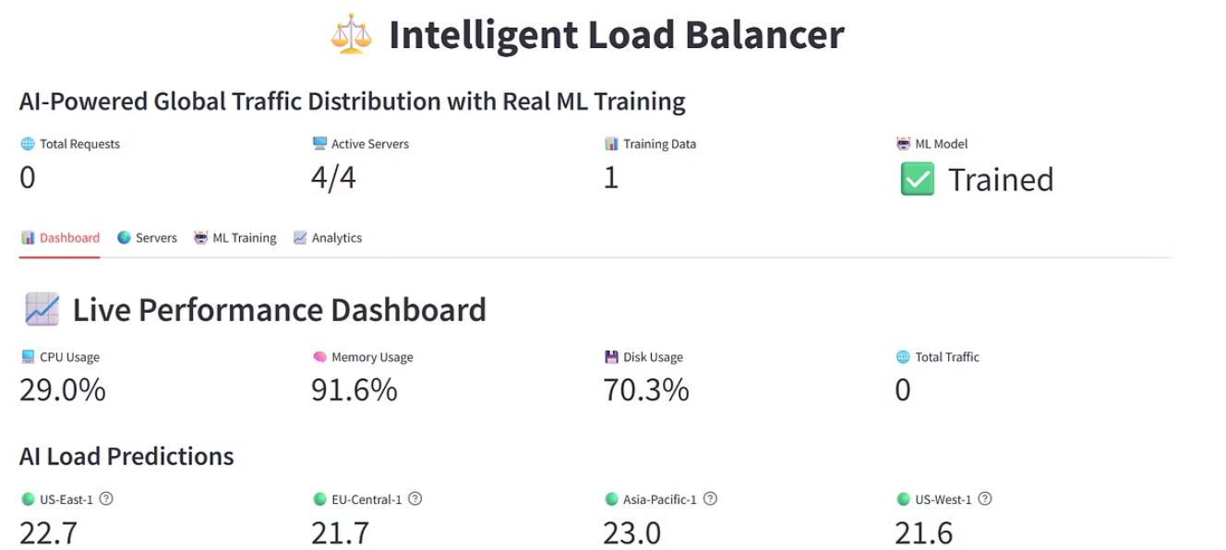


Our Solution: Predictive Load Balancing
We integrate ML forecasting with traditional load balancing for proactive traffic management.
Intelligent ML
UNIX Daemons
Adaptive Decisions
Uses predictive analytics for optimal traffic distribution.
Ensures continuous, background monitoring and data collection.
Enables real-time, adaptive routing based on forecasted load.

Slide 4
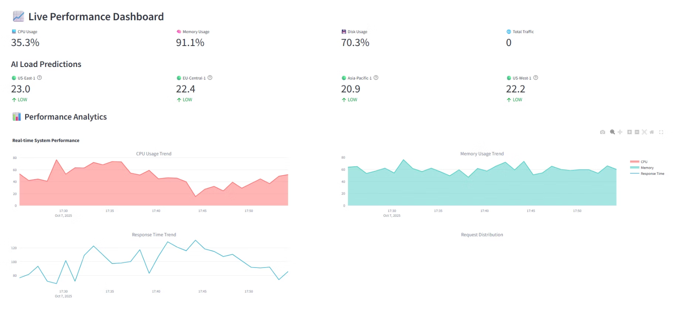
Project Abstract & Performance
An AI-powered system using cloud-deployed ML models and UNIX daemons for superior load management.
Technical Features
Performance Results
Random Forest regression for load prediction.
40%
87%
Analysis of 13 server metrics.
Multi-threaded health monitoring and automated failover.
Faster Response
Prediction Accuracy
Improvement in overall system response times.
High accuracy in forecasting server load.
99.2%
System Availability
Ensuring reliable, continuous operation.

Slide 5




Key Project Features
Predictive Capabilities
Comprehensive Dashboard
ML models forecast server loads, enabling proactive traffic distribution and pattern recognition.
Real-time performance visualization, interactive analytics, and system configuration interface.
Cloud Native
Intelligent Routing
Scalable architecture, containerization-ready, supporting multi-cloud deployment strategies.
Multi-factor server scoring, adaptive algorithm selection, and geographic awareness for routing.

Slide 6

System Implementation: Architecture
UNIX Daemons
Machine Learning
Load Balancing
Server Management
Core Components
Key Algorithms
Machine Learning Module: EnhancedMLPredictor class, Random Forest, Feature engineering.
The system relies on a Random Forest model with 150 estimators, a multi-factor scoring algorithm, and predictive load distribution logic.
Load Balancing Core: IntelligentLoadBalancer, Server scoring, Connection management.
Server Management: ServerPool, Health monitoring, Metrics collection.
UNIX Daemons: Background processes for continuous monitoring and automation.

Slide 7




Software & Development Environment
Software Configuration
Development Tools
Language & ML
Python 3.8+, scikit-learn, pandas, numpy.
Jupyter Notebook for ML development.
Frontend
Streamlit and Plotly for interactive visualization.
VS Code/PyCharm for coding.
OS & Libraries
Linux/Unix-based systems, psutil, threading.
Git for version control.
Docker for containerization.

Slide 8
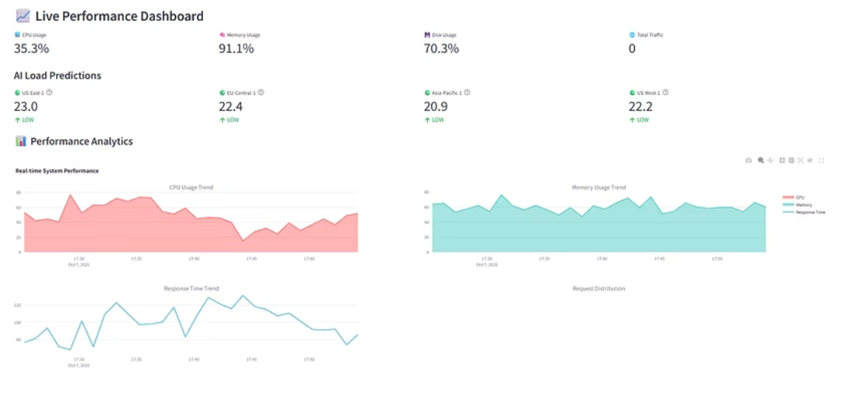
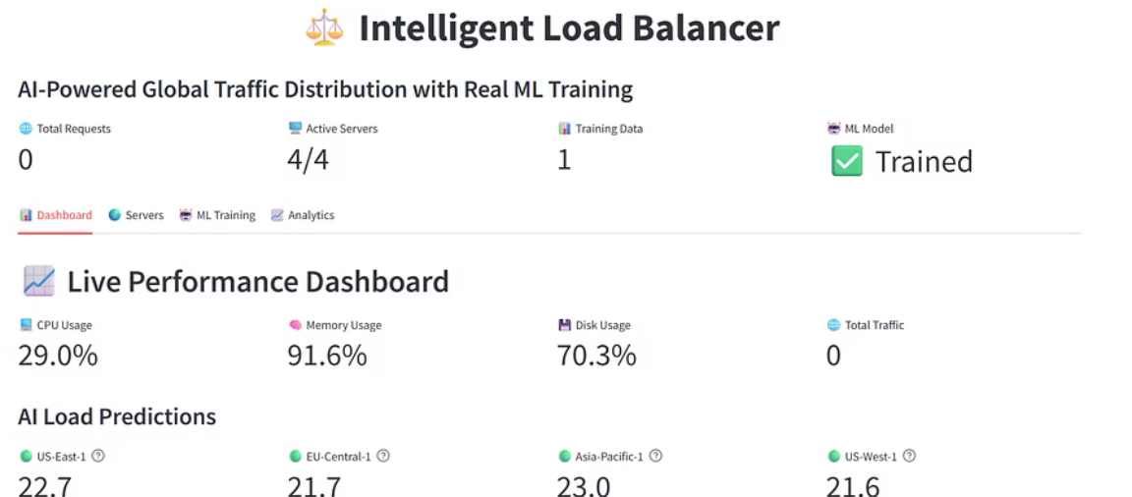
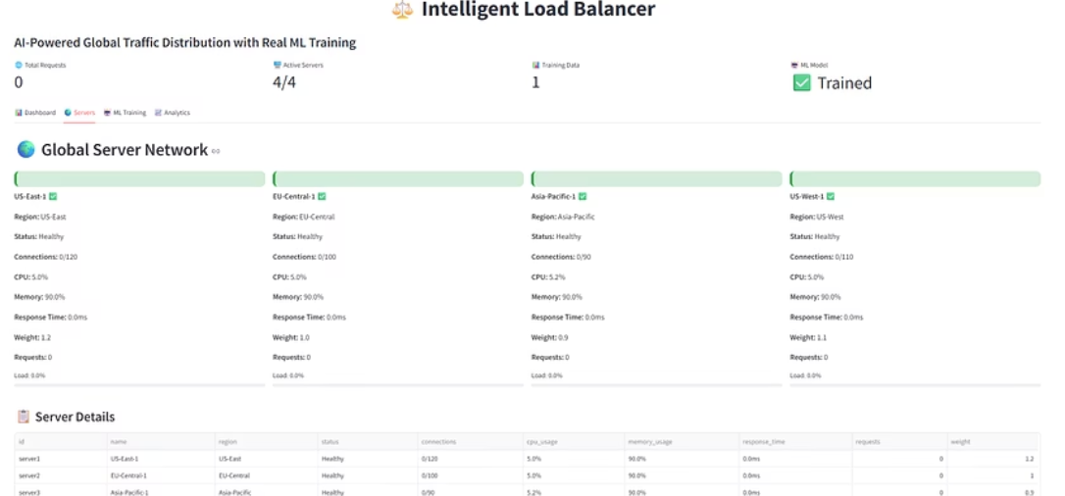
System Output & Monitoring
The comprehensive dashboard provides real-time insights into system performance and ML model accuracy.
Visualization
Monitoring
CPU/Memory usage trends, response time analytics, and prediction accuracy graphs.
Live server status, connection tracking, error rate monitoring, and performance benchmarking.

Slide 9




Project Conclusion & Impact
Key Achievements
ML Integration
Performance
Achieved 87% prediction accuracy.
40% faster response times.
Reliability
Scalability
99.2% system availability.
Supports 1000+ concurrent connections.
Proactive load balancing is feasible and effective, setting a foundation for autonomous infrastructure management.

Slide 10

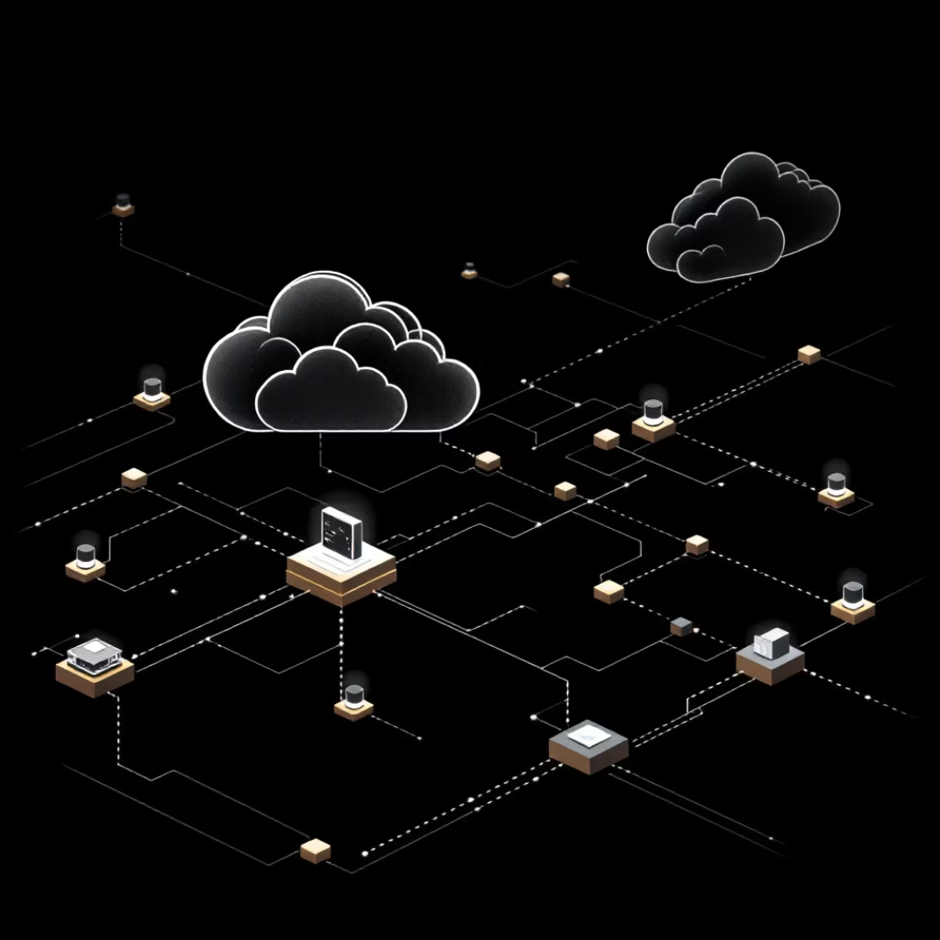

Future Scope & Research
Short-Term (0-6 months)
Medium-Term (6-18 months)
Long-Term & Research
LSTM networks for time-series forecasting.
Real-time anomaly detection.
Federated learning and Edge computing extension.
Docker containerization and multi-cloud support.
Cloud auto-scaling integration.
Advanced analytics and reporting.
Reinforcement learning for optimization.
Energy-aware load balancing.

Slide 11
References & Resources
Technical Literature:
Breiman, L. (2001). "Random Forests." Machine Learning
Pedregosa, F., et al. (2011). "Scikit-learn: Machine Learning in Python"
Cardellini, V., et al. (1999). "Dynamic Load Balancing on Web-server Systems"
Online Resources:
Python Documentation: https://docs.python.org/
Streamlit Documentation: https://docs.streamlit.io/
Scikit-learn User Guide: https://scikit-learn.org/
Plotly Python Documentation: https://plotly.com/python/eferences

